Slide 1

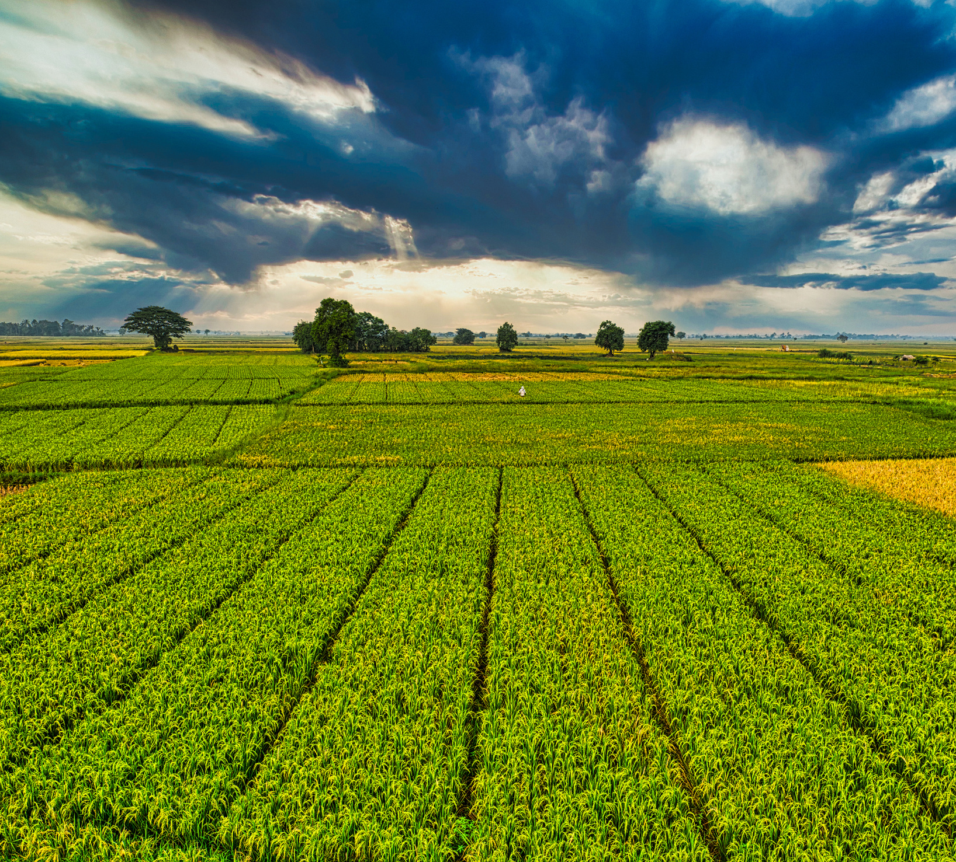

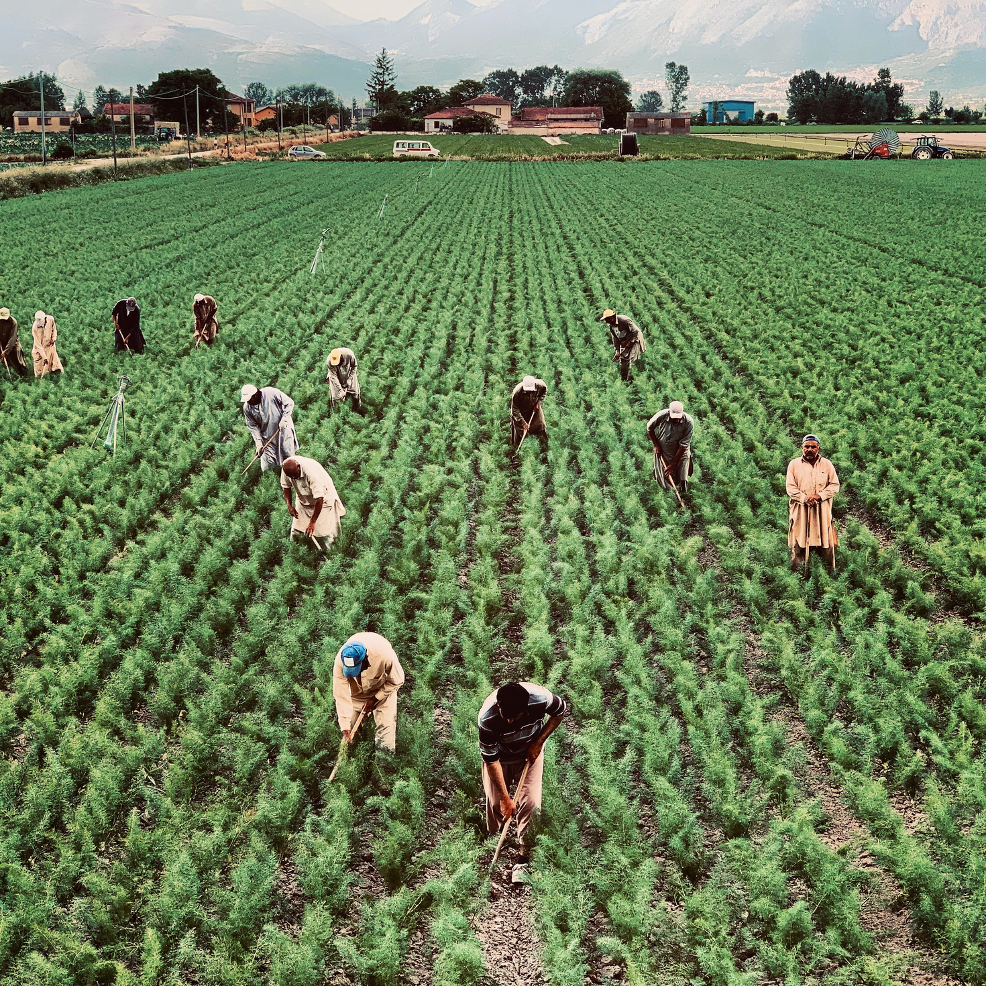

AI-BASED CROP RECOMMENDATION SYSTEM
PRESENTED BY
STUDENT NAME: ANNAREDDY HIMA VARSHINI
COLLEGE NAME: AMRITA VISHWA VIDYAPEETHAM,AMRITAPURI
DEPARTMENT: BTECH,CSE
EMAIL ID:HIMAVARSHINIANNAREDDY@GMAIL.COM
AICTE Student ID:

Slide 2
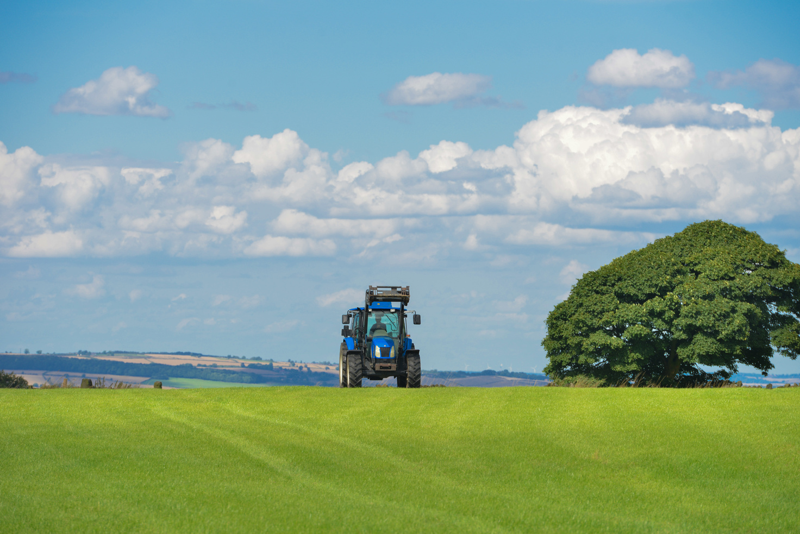
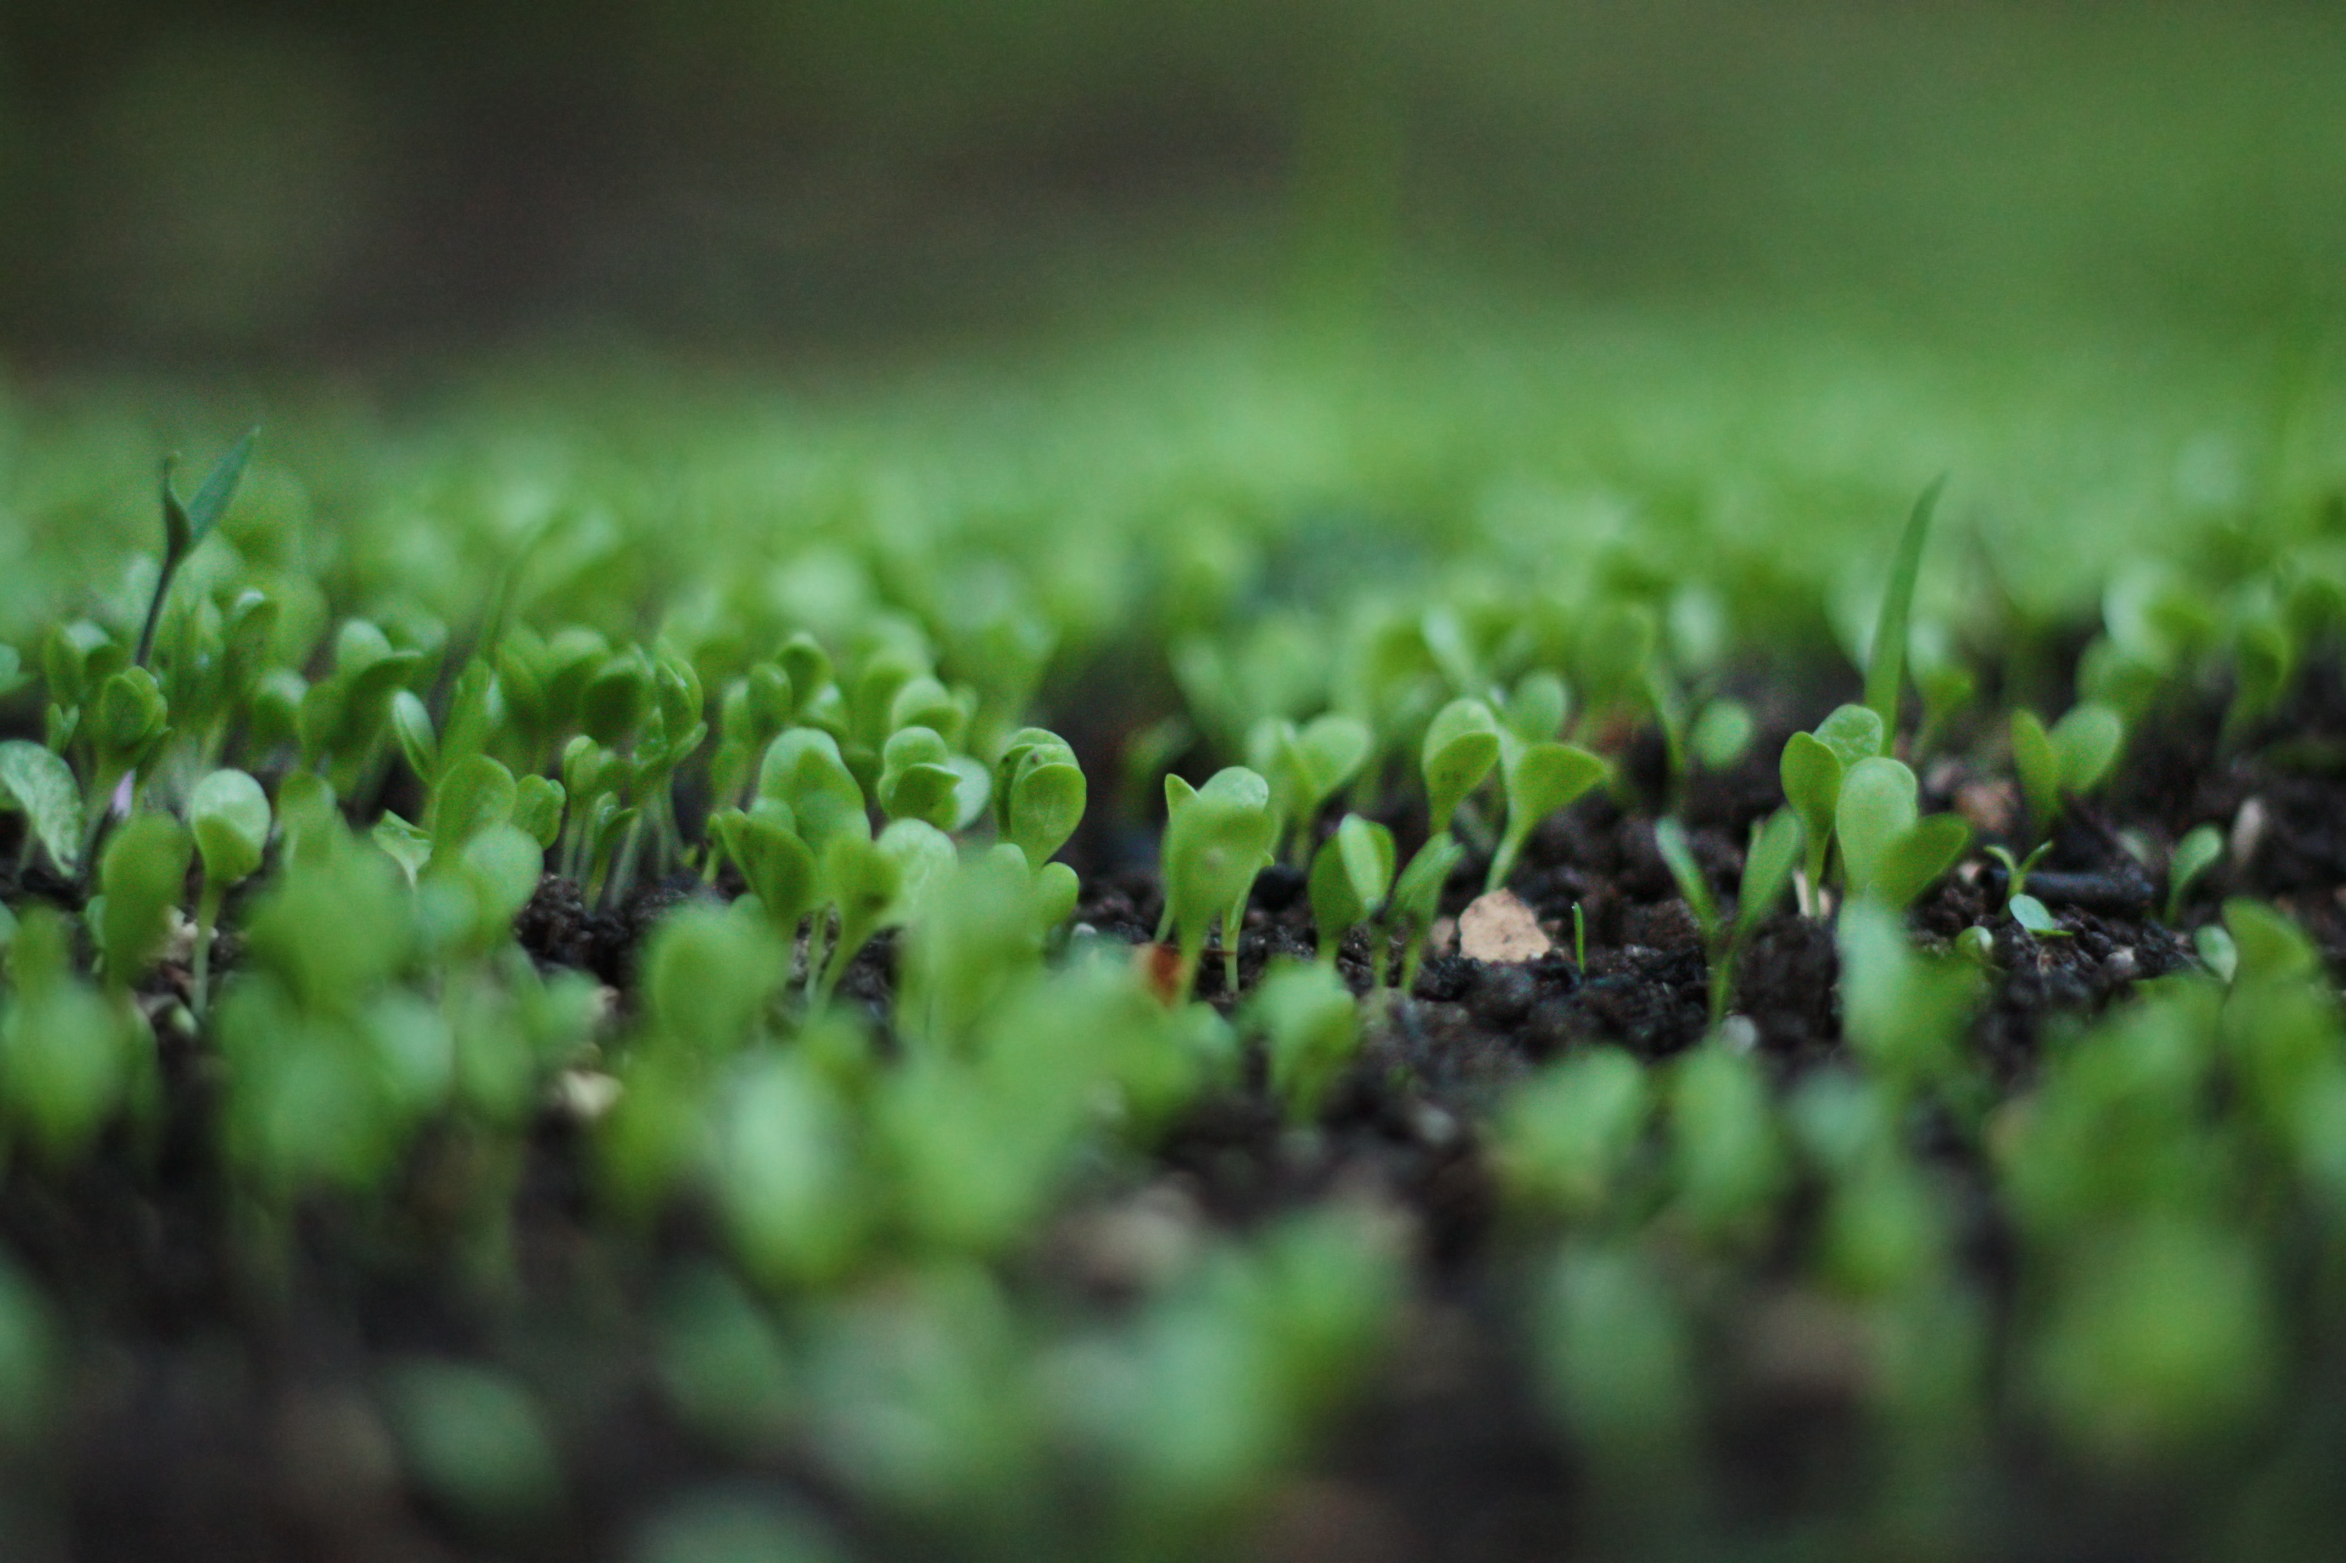
OUTLINE
•Problem Statement
•Proposed Solution
•System Development Approach
•Algorithm & Deployment
•Result
•Conclusion
•Future Scope
•References

Slide 3
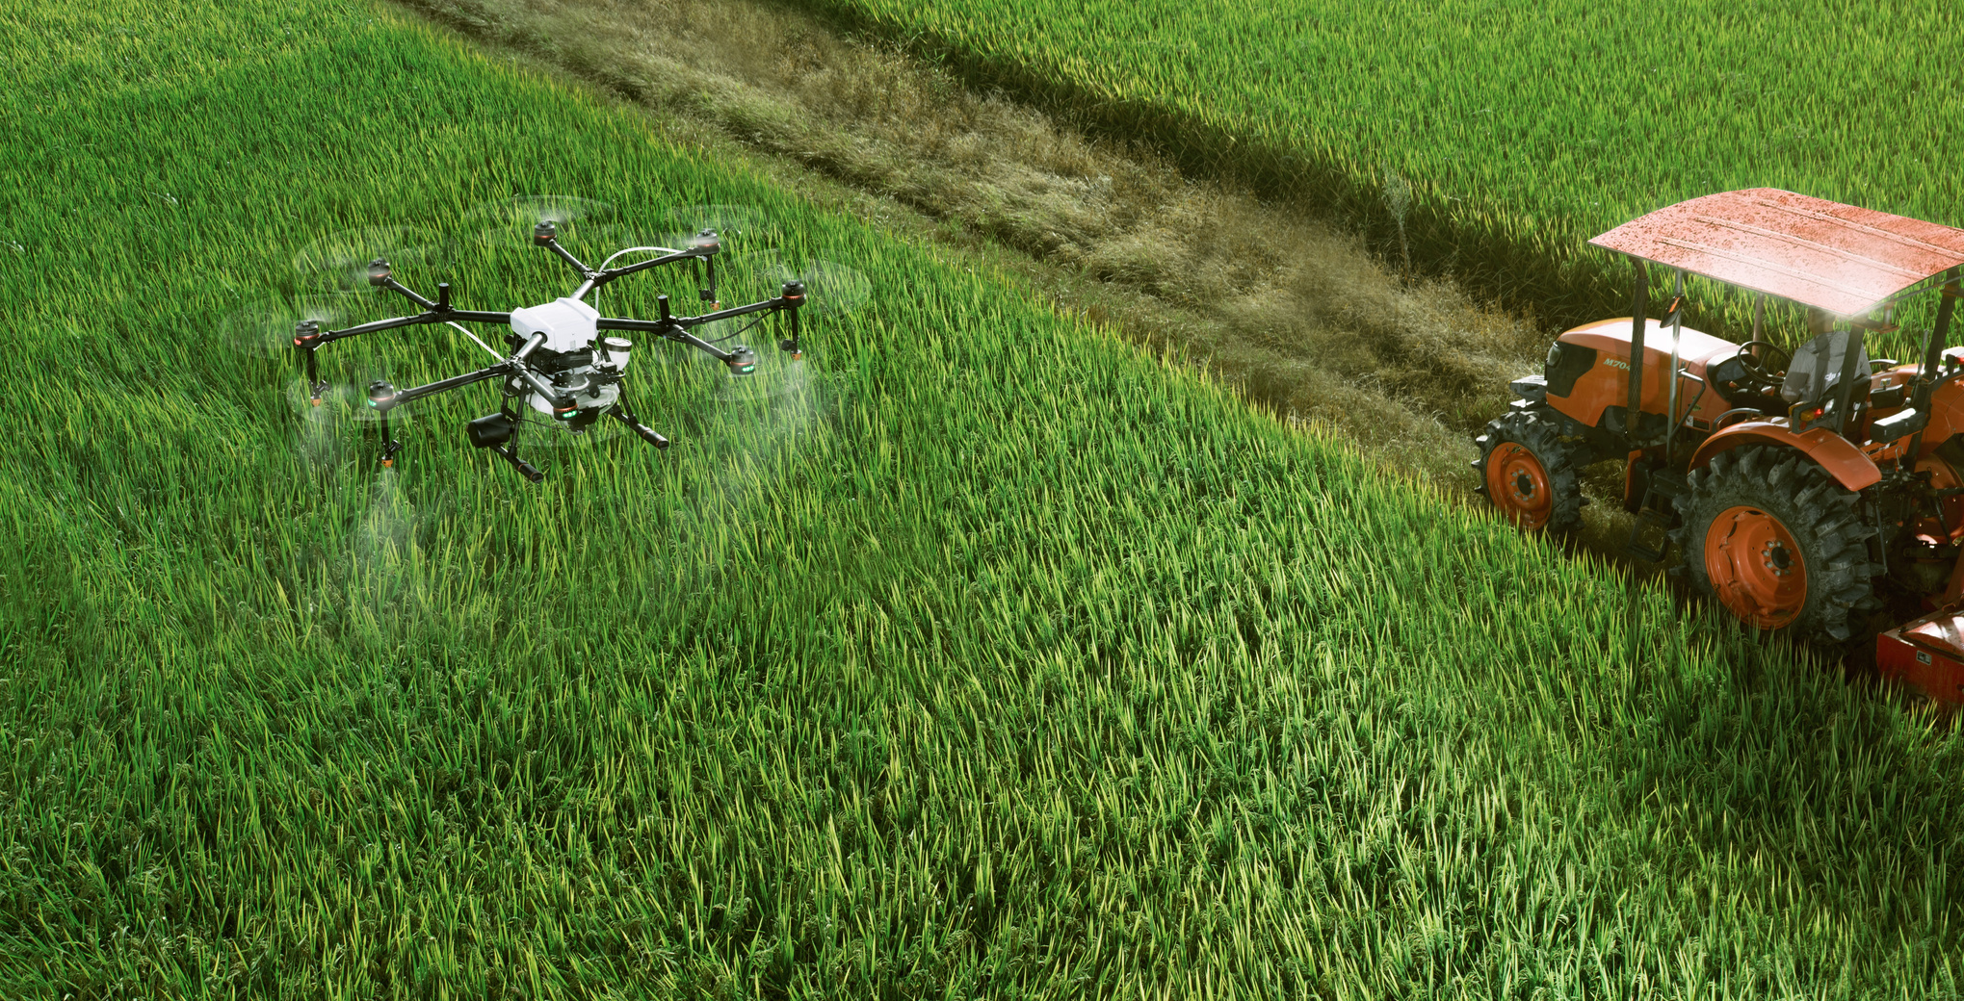
PROBLEM STATEMENT
Farmers struggle to choose the right crop due to variable soil and weather conditions.
Traditional decisions are not data-driven and often lead to poor yield.
A solution is needed to scientifically recommend suitable crops.

Slide 4
PROPOSED SOLUTION
Built a machine learning model trained on agricultural data.
Used environmental inputs: N, P, K, temperature, humidity, pH, rainfall.
Deployed an interactive Streamlit app for instant crop prediction.

Slide 5
TECHNOLOGIES
Python, Streamlit, scikit-learn
SYSTEM DEVELOPMENT APPROACH
LIBRARIES
pandas, numpy, joblib, RandomForestClassifier
TOOLS
Jupyter Notebook, GitHub

Slide 6
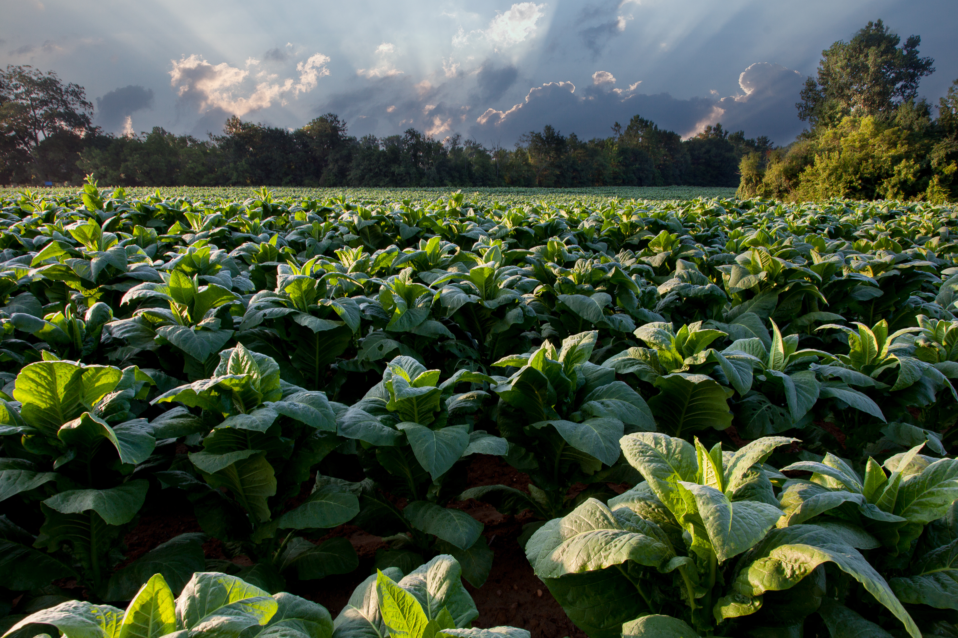
ALGORITHM & DEPLOYMENT
MODEL
Steps:
Preprocess dataset
Train model and save it
Create Streamlit UI
Deploy app locally or online
RandomForest
Classifier

Slide 7
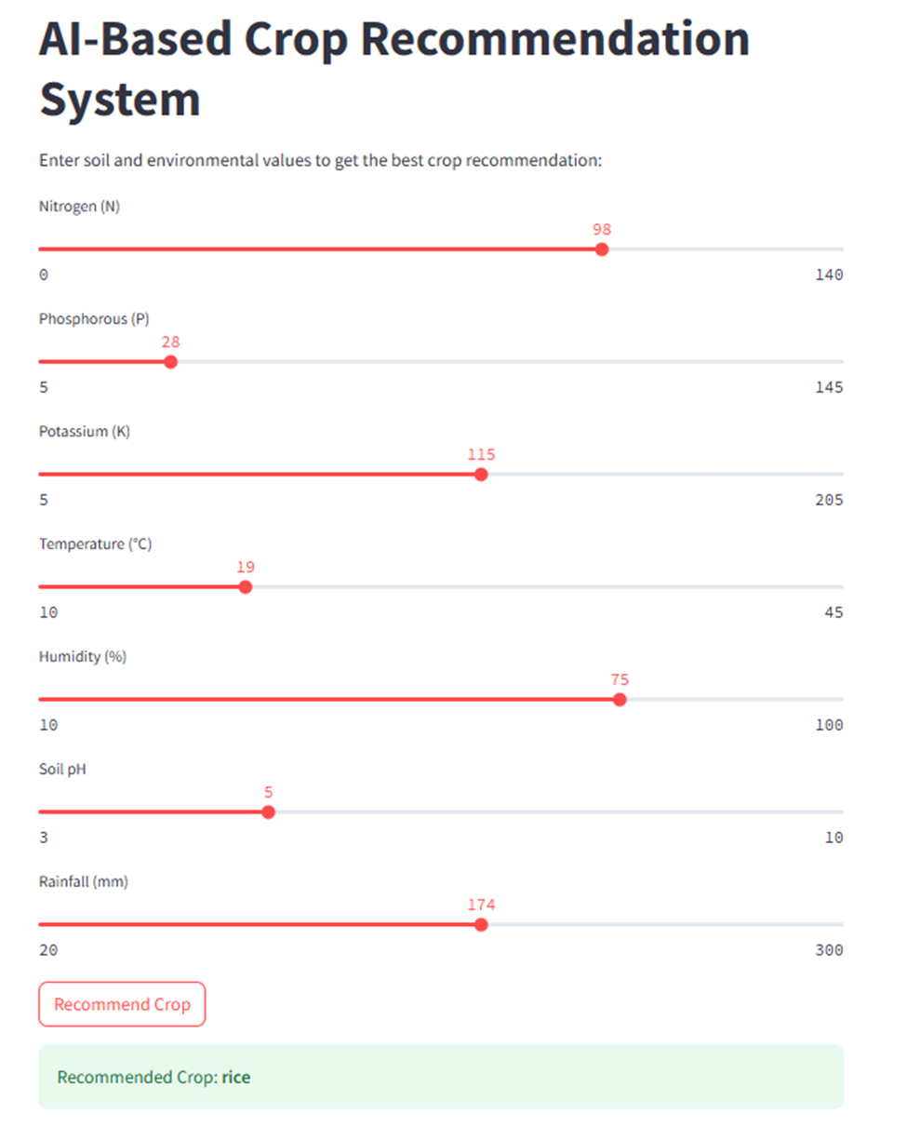

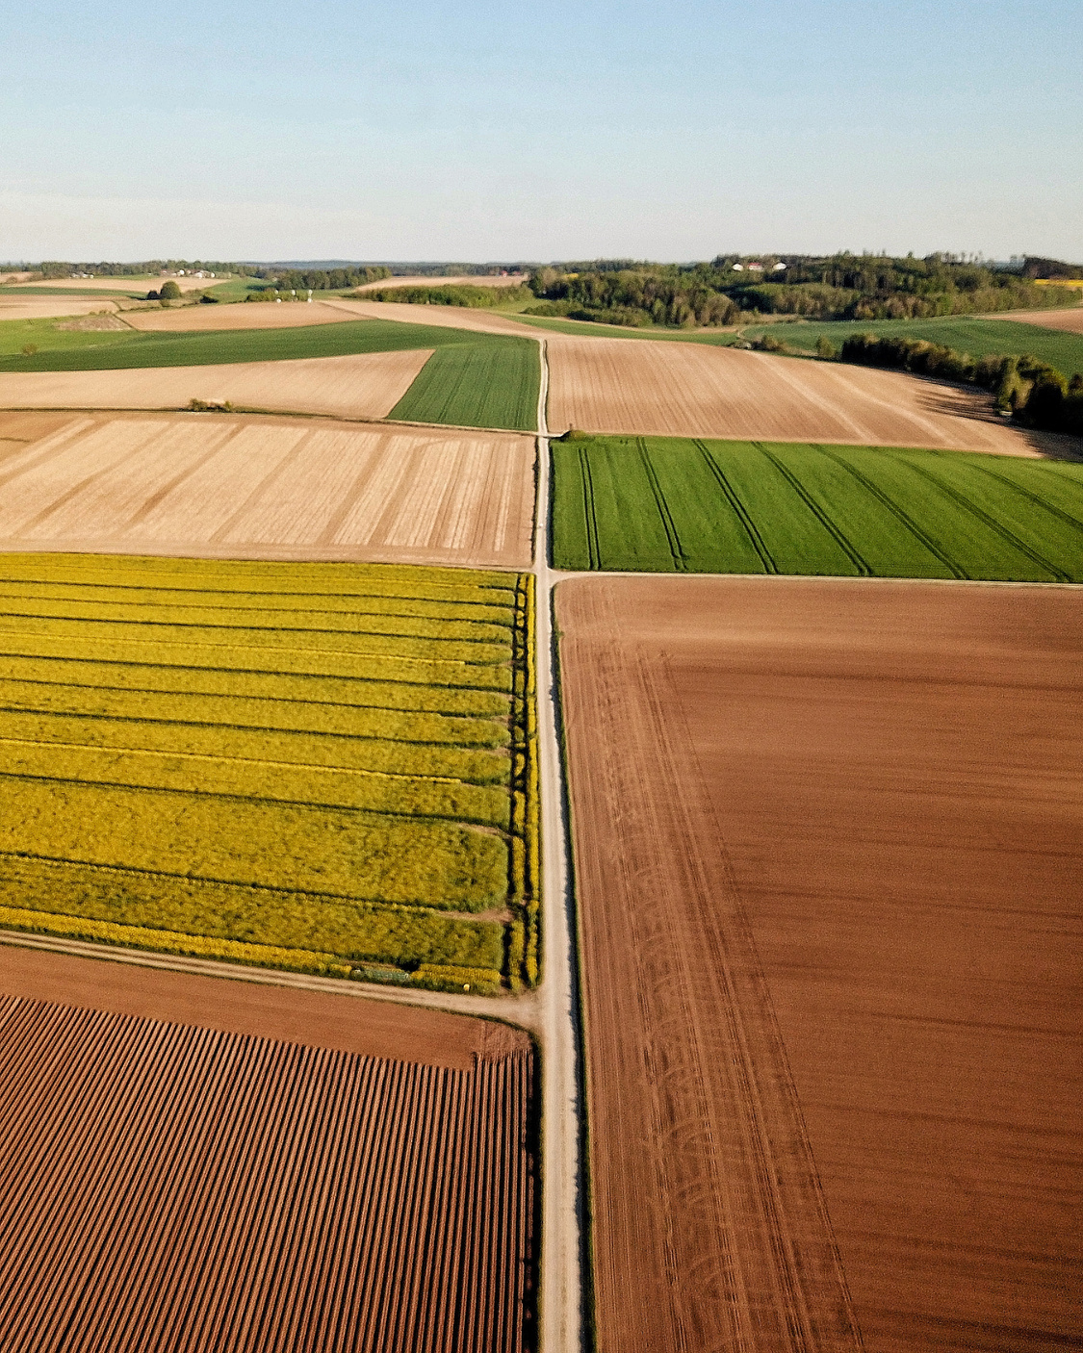
Screenshot of the working app
RESULT
•Model Accuracy: ~99%

Slide 8
CONCLUSION
•The system accurately recommends crops based on inputs.
•It is accessible, user-friendly, and relevant for real-world use.
•Demonstrates how AI can support smart agriculture.
PAGE 12

Slide 9
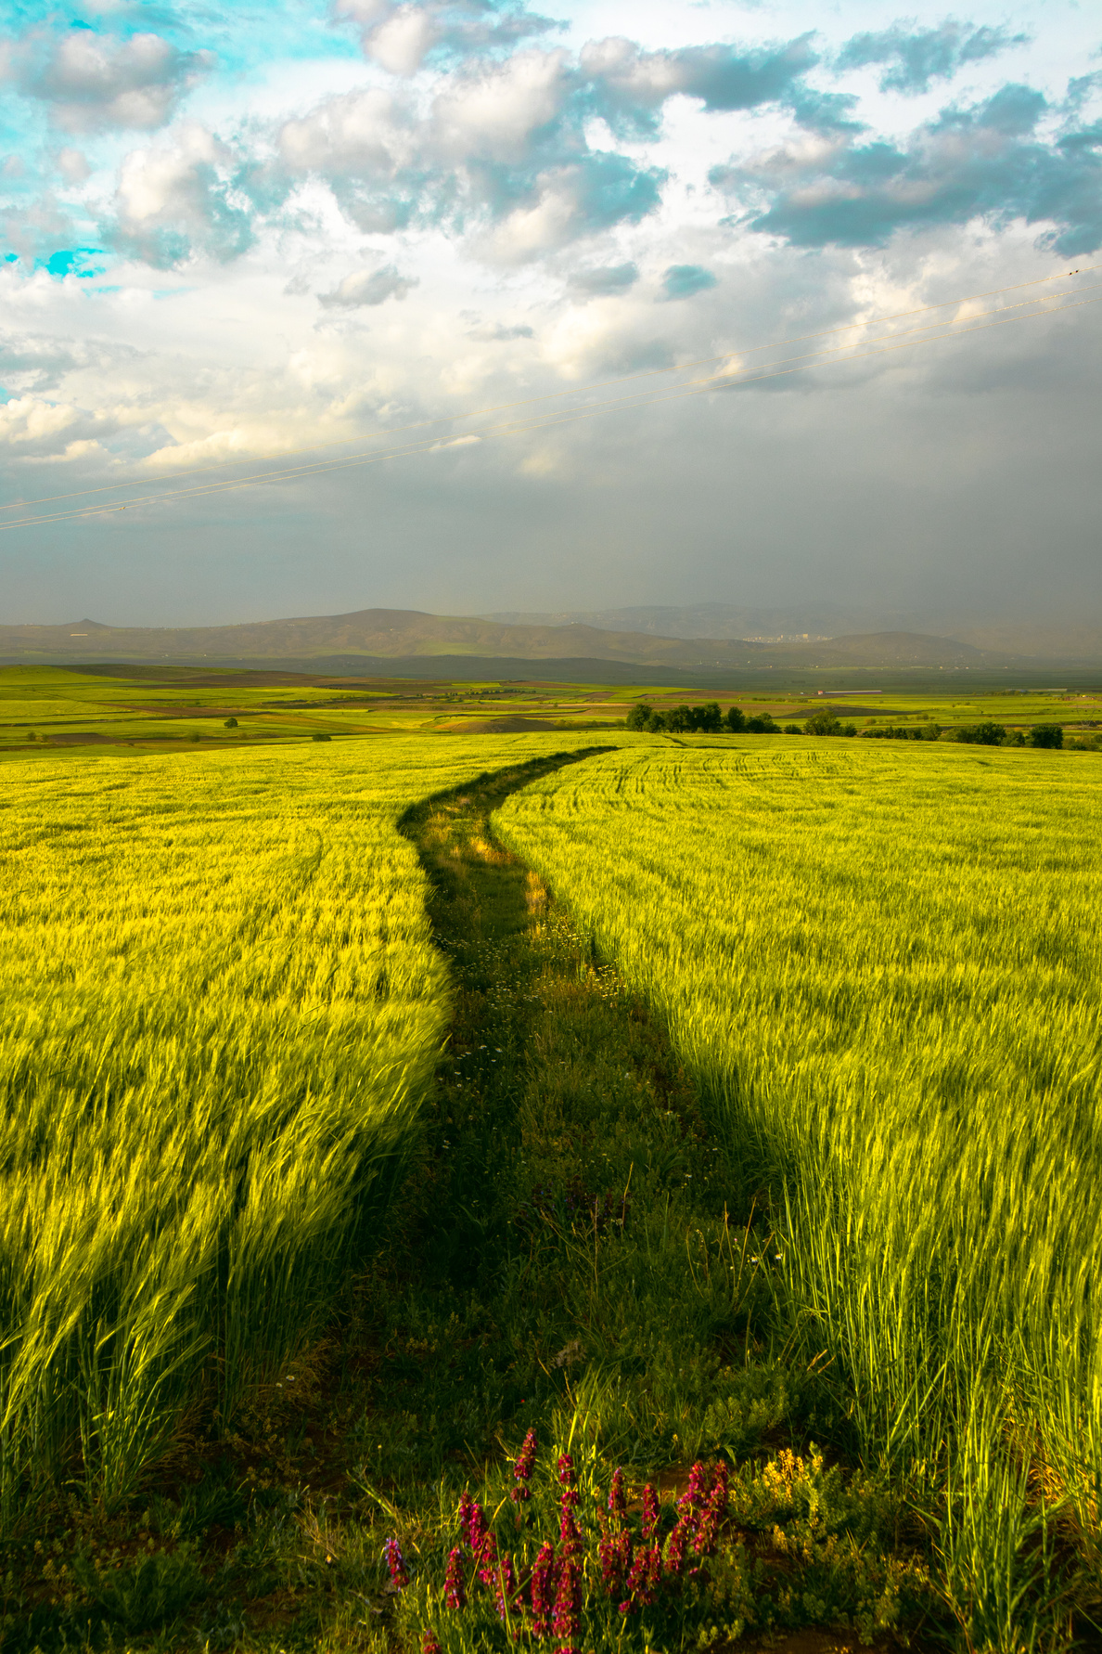
FUTURE SCOPE
•Integrate real-time weather data APIs.
•Add fertilizer recommendation module.
•Translate interface into local languages.
•Deploy mobile version for accessibility in remote areas.

Slide 10
REFERENCES
•Kaggle Crop Recommendation Dataset
•scikit-learn Documentation
•Streamlit Documentation
•GitHub Link: https://github.com/HIMAVARSHINI-AHV/AI-Crop-Recommendation-System

Slide 11
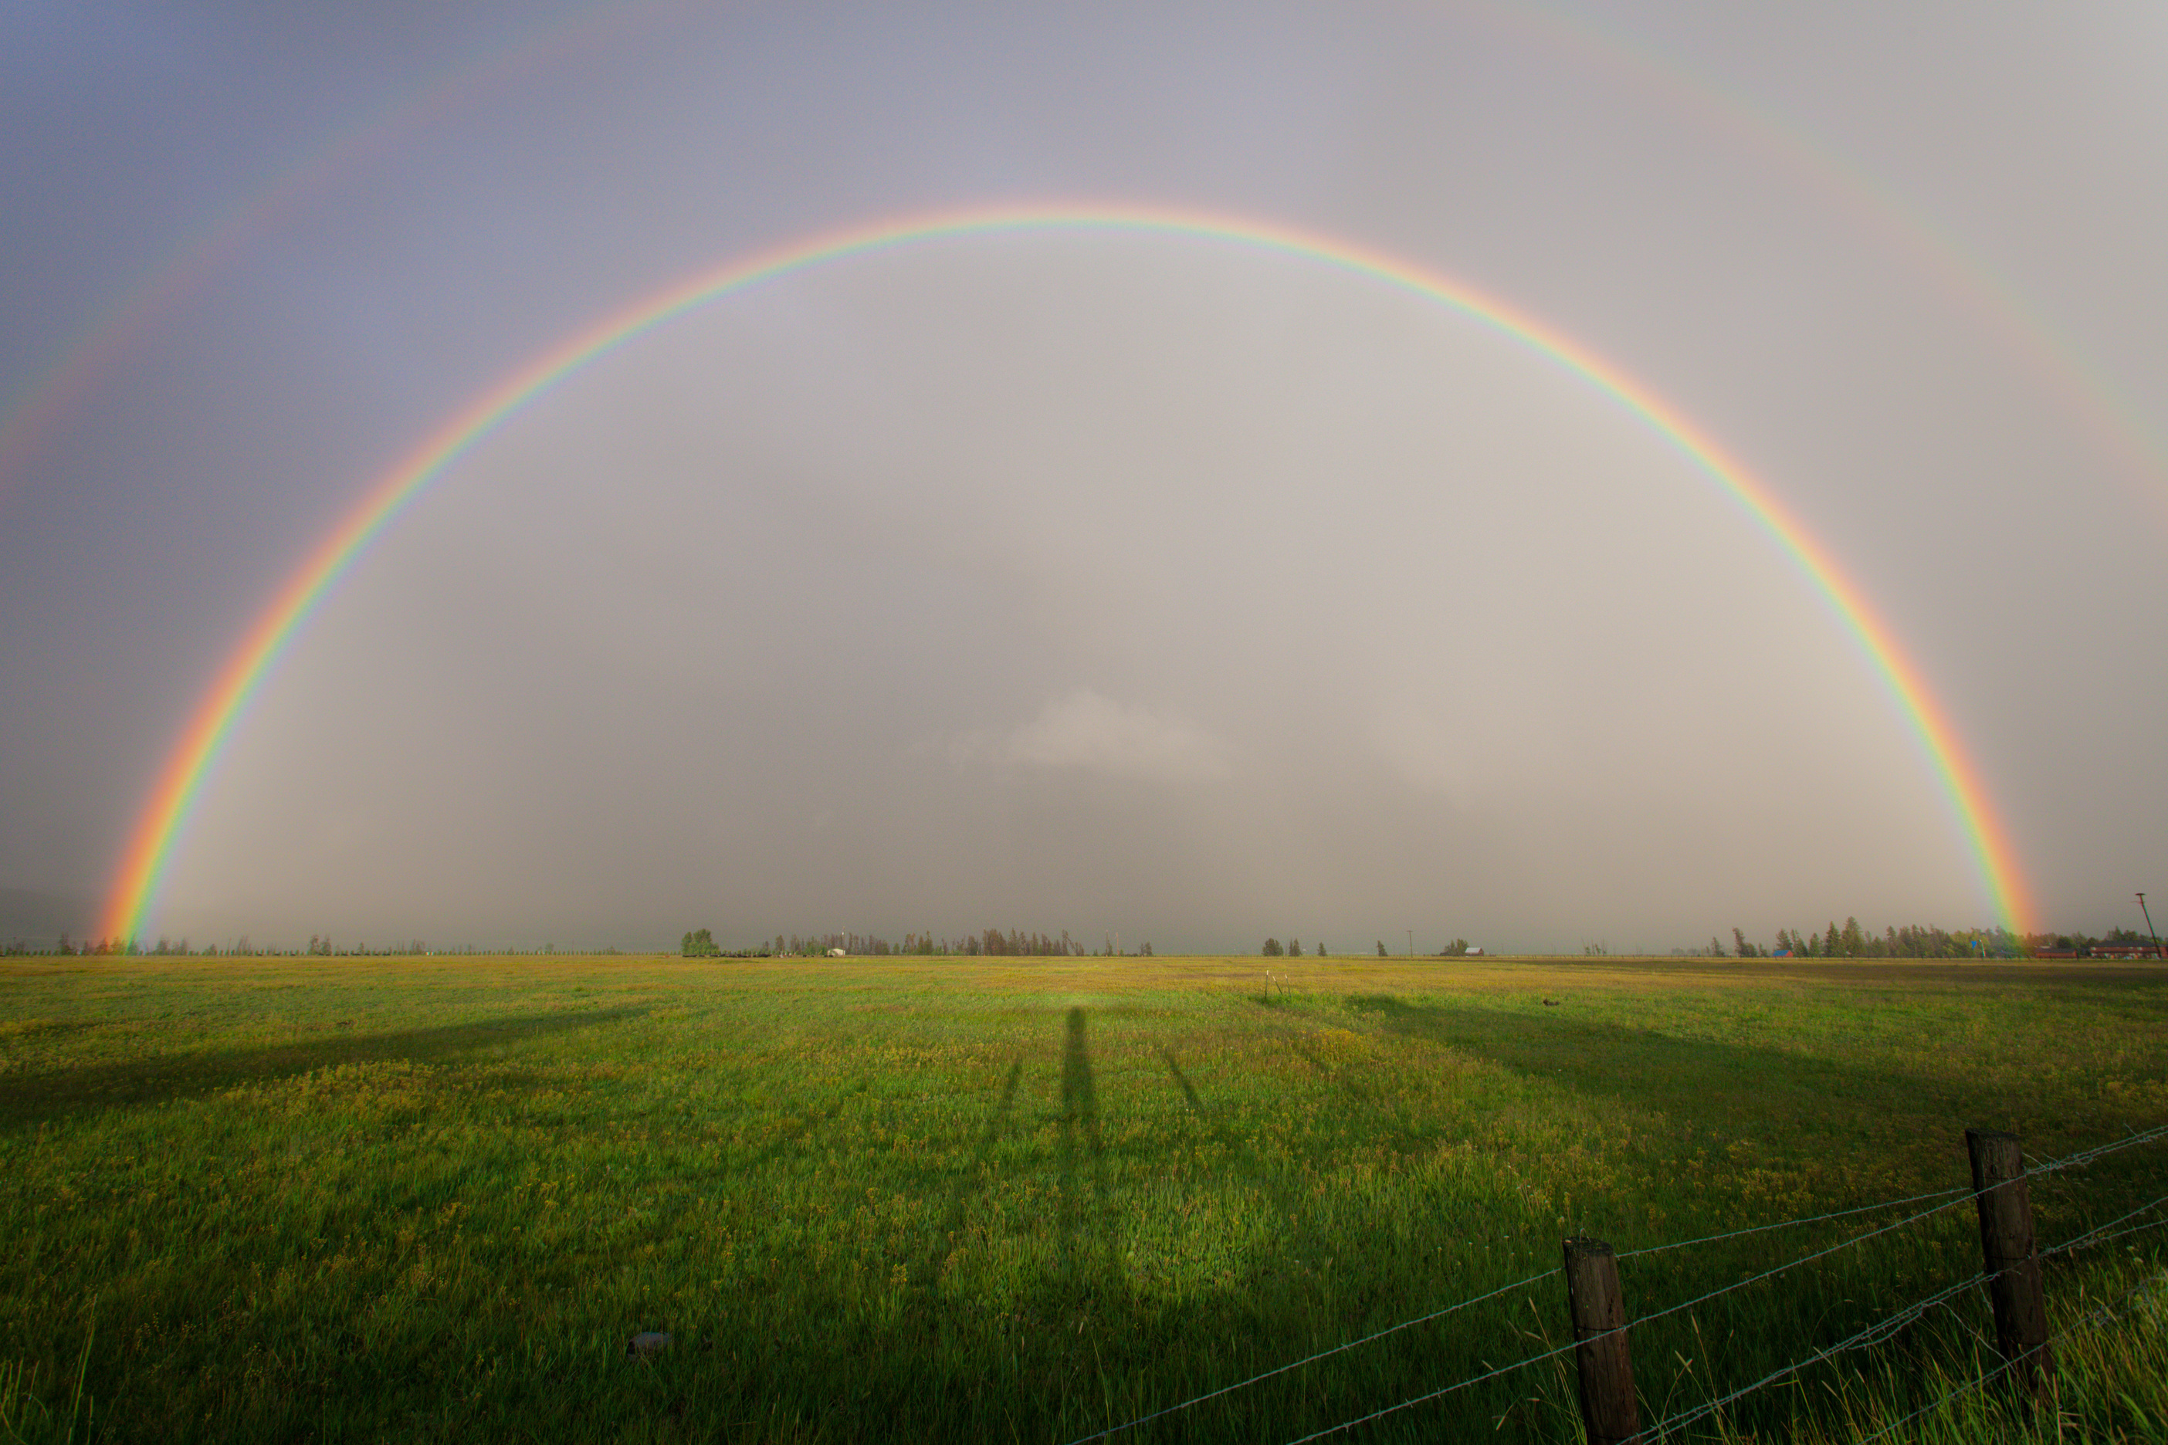
THANK YOU.

